Slide 1
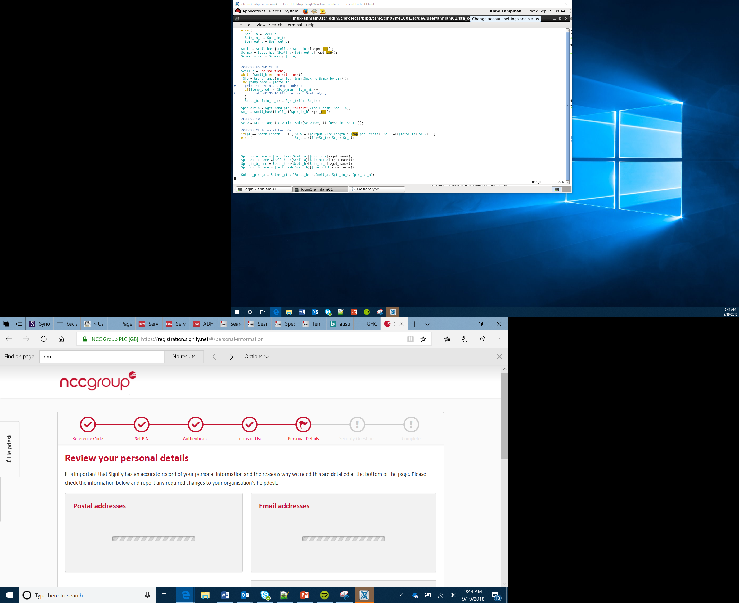

Radio Communication and Ciphers
Lesson 8

Slide 2

Radio Communication
Mobile devices need to communicate with other devices
If you use a smartphone to connect to the Internet you use radio waves to do this
The strength of the signal gets weaker as you move further away from the transmitter
Physical objects which get in the way also reduce the signal strength
As the signal strength gets weaker the speed of the data transfer slows
This Photo by Unknown Author is licensed under CC BY-NC
Notes:
Discuss how physical objects such as walls can reduce the wireless signal and thus result in a slower speed. The further you are away from the router the weaker the signal.

Slide 3

Security
As information is being transmitted through the air other people could intercept it
It is important that this information is kept secure so that if someone were to intercept it, they wouldn’t be able to understand it
To make sure the information is hidden this data is encoded
This Photo by Unknown Author is licensed under CC BY-SA
Notes:
You could expand this by asking Learners what they think could happen if people were able to steal the data that was being transmitted from their mobile devices such as phones. You could draw out the amount of personal data that is communicated like passwords and the threats that exist if someone were to steal this data.

Slide 4

Encryption
The process of encoding data is known as encryption
To encrypt data, we apply a special algorithm called a cipher
The cipher is applied to the plain message so that it is scrambled
This Photo by Unknown Author is licensed under CC BY-NC-ND

Slide 5
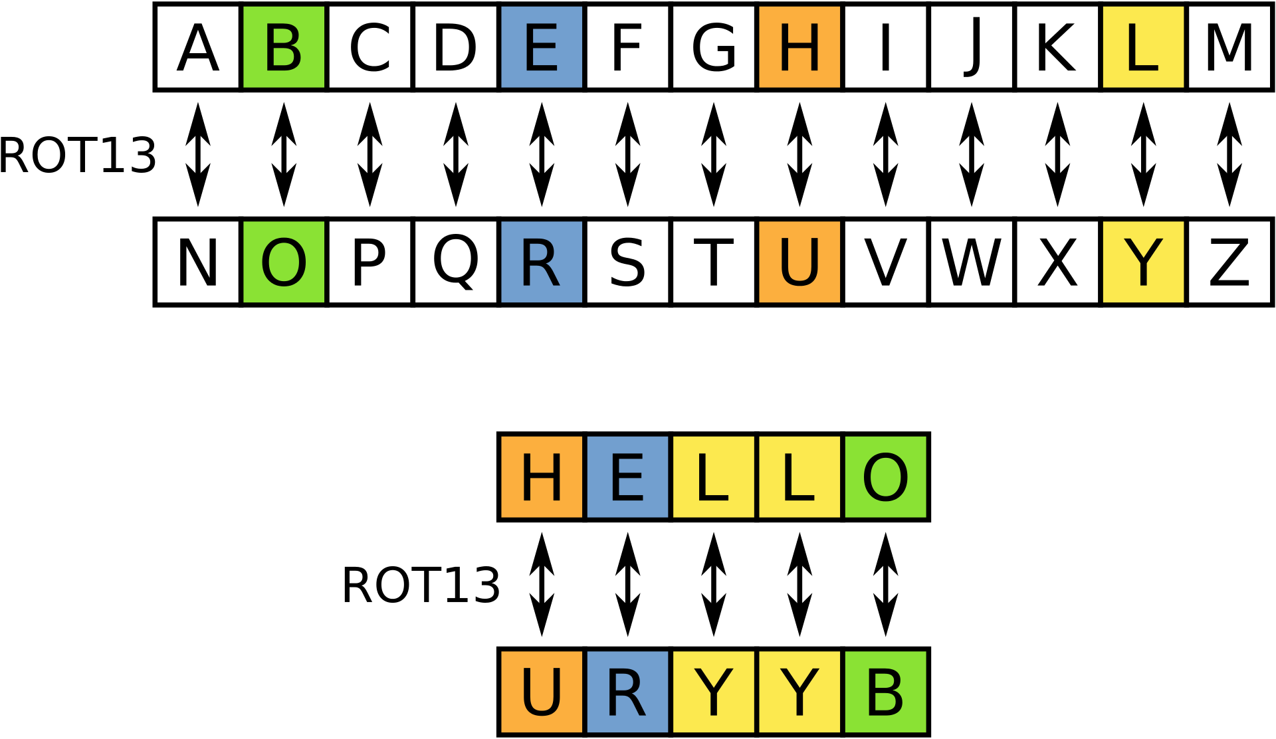
Caesar Cipher
One of the oldest encryption ciphers is called the ‘Caesar Cipher’. It is believed that Julius Caesar used the cipher when sending messages
The cipher shifts each letter in the message by a specific number of characters to encrypt it.
If the shift was +3 the word ‘cat’ would be encrypted to ‘fdw’.
Try to work through the Cipher Worksheet to see if you can crack the secret message and also come up with some of your own
This Photo by Unknown Author is licensed under CC BY-SA
Notes:
The Caesar Cipher is one of the most basic ciphers. It works by shifting letters a number of positions in the alphabet. The image show how the word HELLO would be encrypted using a shift of 13. This means that an A would be moved 13 places along the alphabet to become an N.

Slide 6
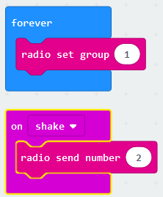
The micro:bit and Channels
The micro:bit is able to communicate with another micro:bit using Radio blocks in MakeCode:
If the two devices are going to communicate then they must use the same channel
Different channels can be used to communicate wirelessly with different devices
We set the radio channel to the desired channel using radio set group, in this example ‘1’
Remember to include the channel in a forever loop because we always want to use channel 1 in this program on both the sending and receiving micro:bit

Slide 7
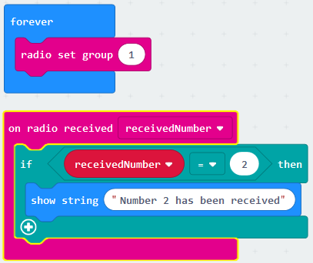
Sending and Receiving Data Between micro:bits
Sending:
Set the radio channel to 1
When the micro:bit is shaken it will send number ‘2’ on channel 1
Receiving:
Set the radio channel to 1
If it receives the number ‘2’ on channel 1 it will print on screen ‘Number 2 has been received’

